Slide 1
AI-Assisted Coding and Developer Skill Development
Supervised By
Dr. Preeti Saini
Kartik Sharma (2210991758)
Department of Computer Science and Engineering, Chitkara University, Punjab

Slide 2
Introduction
Artificial Intelligence (AI) is revolutionizing modern software development.
AI-assisted coding tools help developers generate, debug, and optimize code efficiently.
Platforms like ChatGPT and GitHub Copilot are widely used for coding assistance.
AI improves productivity, reduces repetitive tasks, and accelerates learning.
This research explores the impact of AI-assisted coding on developer skill development and software engineering practices.

Slide 3
Objective
Analyze the role of AI in software development.
Study the impact of AI-assisted coding on developer productivity.
Evaluate how AI tools support learning and debugging.
Identify the advantages and limitations of AI-assisted development.
Understand the future scope of AI in programming and software engineering.

Slide 4
Problem Statement
Developers spend significant time on repetitive coding and debugging tasks.
AI coding assistants accelerate development but may reduce analytical thinking and conceptual understanding.
Overdependence on AI-generated code can affect software maintainability and quality.
Existing studies focus mainly on productivity while ignoring long-term skill development and dependency issues.
There is a need for a balanced evaluation of productivity, dependency, and software quality in AI-assisted development.

Slide 5
Methodology
Research Design
- Conducted a controlled experimental study with AI-assisted and control groups.
- AI-assisted group used GitHub Copilot and AI tools during development tasks.
- Control group performed manual coding without AI assistance.
Evaluation Parameters
- Task completion time
- Cyclomatic complexity
- Developer Dependency Score (DDS)
Experimental Process
- Participant recruitment
- Task execution
- Data collection
- Code quality analysis
Technologies Used
GitHub Copilot
ChatGPT
Visual Studio Code
Python & JavaScript

Slide 6
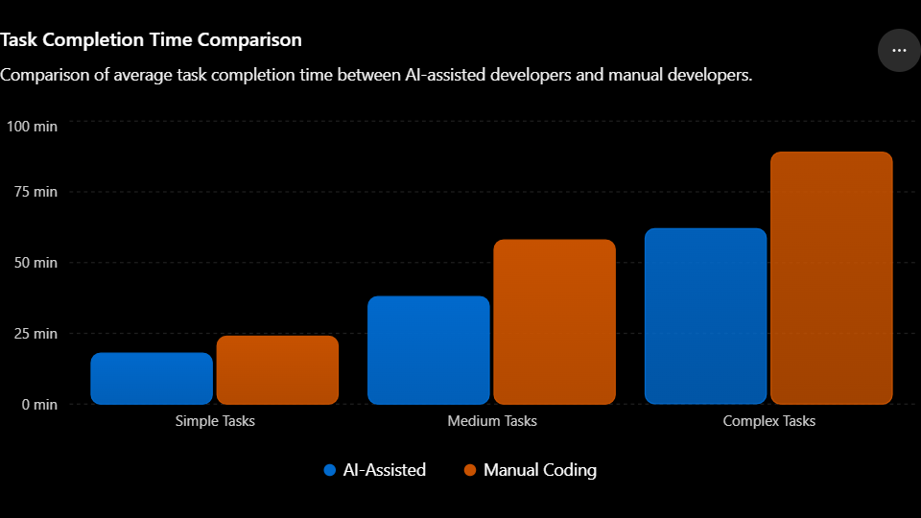
Productivity Comparison

Slide 7
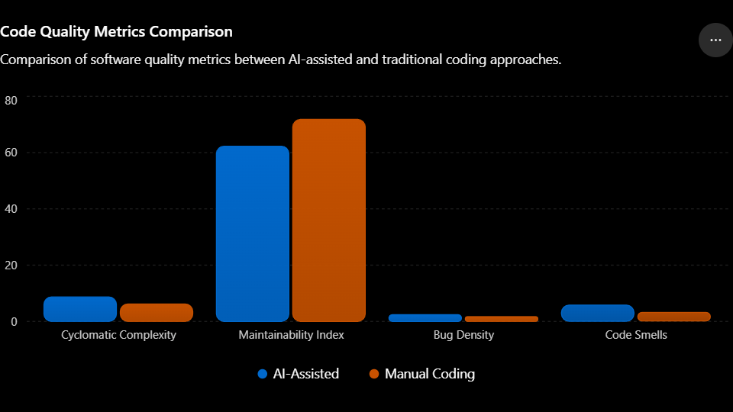
Code Quality Comparison

Slide 8
Results & Discussion
AI-assisted developers completed tasks 35–50% faster than manual developers.
Junior developers showed higher dependency on AI tools compared to senior developers.
AI-generated code exhibited:
Higher cyclomatic complexity
Increased bug density
Lower maintainability index
Comparative Analysis Metric | AI-Assisted | Human Group
Productivity | Higher | Moderate
Code Maintainability | Lower | Higher
Bug Density | Higher | Lower
Development Speed | Faster | Slower

Slide 9
Conclusion
- AI-assisted coding is reshaping modern software engineering practices.
- AI tools provide substantial productivity and workflow improvements.
- Increased dependency on AI can negatively impact conceptual understanding and software quality.
- AI should function as a collaborative assistant rather than a replacement for developers.
- Responsible AI integration requires balancing automation with strong programming fundamentals.
- Future research should focus on long-term dependency analysis and sustainable AI-assisted learning models.

Slide 10
Thank You
3

